Slide 1

Predicting Part 3 CGPA
Using Supervised Learning & Linear Regression
A practical exploration of how past academic performance can forecast future outcomes through machine learning

Slide 2

Supervised Learning: The Foundation
Supervised learning uses labelled data to train models that predict outcomes. Two primary tasks exist:
Regression
Predicting continuous numerical values, like Predicting CGPA, house prices, or temperatures
Classification
Categorising data into discrete groups or classes, like pass/fail or if an email is spam or not spam.
Our Objective
We build a linear regression model to predict Part 3 CGPA using Part 1 and Part 2 CGPAs as predictors. This demonstrates how historical academic performance patterns can forecast future results, helping students plan their studies strategically and understand learning trajectories.

Slide 3
Dataset & Model Training
Sample Dataset
Training Pipeline
Our dataset contains 15 students' academic records tracking performance across three parts of their degree programme:
1
Import Libraries
Load Pandas, Scikit-learn, and NumPy for data manipulation and modelling.
Part 1
Part 2
Part 3
2
Prepare Data
2.5
2.9
3.0
Organise features (Part 1 & 2 CGPAs) and target variable (Part 3 CGPA).
3.0
3.2
3.3
2.6
2.7
2.8
3
Train-Test Split
Allocate 80% for training and 20% for testing model performance.
2.8
2.9
3.1
3.2
3.4
3.5
4
Train Model
Fit linear regression to identify relationships between inputs and output.
5
Evaluate
Assess accuracy using performance metrics on unseen test data.

Slide 4
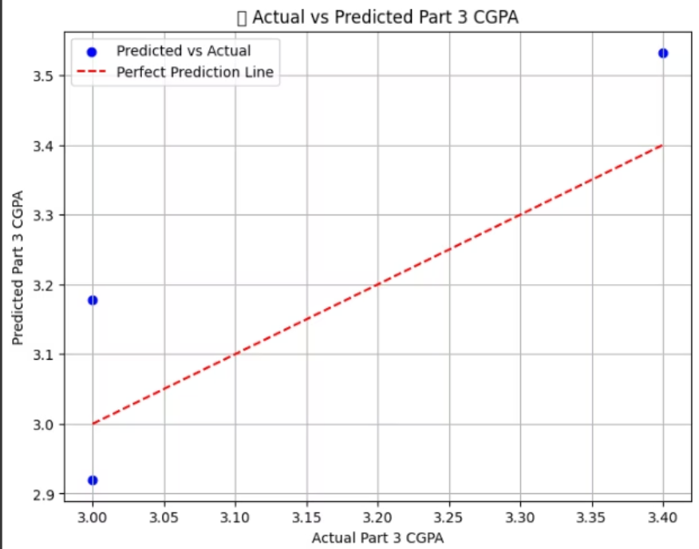

Real-World Prediction Example
📥 Model Input
📤 Predicted Output
Part 1 CGPA: 2.56
Predicted Part 3 CGPA: 3.16
Part 2 CGPA: 2.91
Confidence based on historical trends
✓ Validation
The prediction of 3.16 demonstrates realistic upward progression, reflecting the student's improving trend from Part 1 to Part 2. This validates that our linear regression model captures genuine academic improvement patterns.

Slide 5
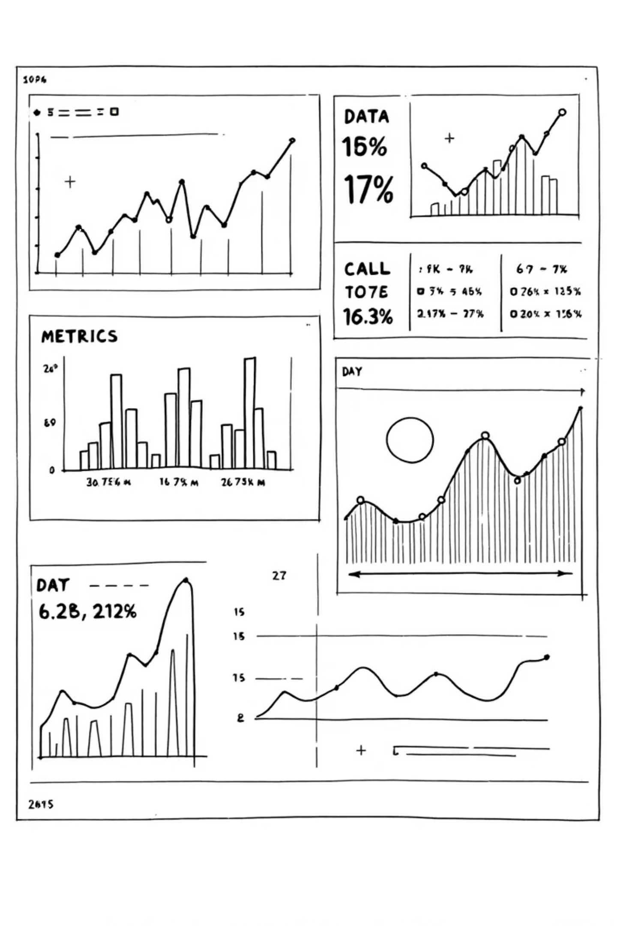
Model Performance & Evaluation
Our linear regression model demonstrates solid predictive capability through key performance metrics:
0.481
0.13
R² Score: 0.481 ➡ Explains 48.1% of variance in Part 3 CGPA, indicating moderate predictive strength from Part 1 and Part 2 performance alone.This means the model can reasonably estimate trends, but other factors (like attendance, assignments, or project marks) may also influence the final CGPA.
Mean Absolute Error
Average prediction error of ±0.13 points on the GPA scale, suggesting predictions are typically accurate within a narrow margin.
On average, the model’s predictions differ from actual CGPA by 0.13 points — showing a fairly accurate and consistent performance

Slide 6

Prediction & Conclusion
Example Prediction
Key Takeaways
Effective prediction: Linear regression successfully models academic performance using historical data.
Student Input
Part 1 CGPA: 2.56
Part 2 CGPA: 2.91
Practical value: Students can estimate future performance and make informed decisions about their studies.
Model Output
Predicted Part 3 CGPA: 3.16
The model forecasts an improvement of approximately 0.25 points, suggesting positive trajectory in academic performance.
Supervised learning power: This demonstrates how labelled training data enables predictive models in educational contexts.

